Slide 1


RESOLVE HACKATHON 2026
HOSPITAL OPD QUEUE & EMERGENCY BED ALLOCATION ENGINE
-SHAYIZA(KITSW B26EC201L)

Slide 2
IDEA TITLE
Hacksphere
Hospital OPD Queue & ER Bed Allocation Engine
Digital OPD token system assigns patients a queue number.
Patients can view their queue position and estimated waiting time.
Emergency patients are identified through triage-based priority.
ER dashboard shows available, occupied and reserved beds.
Doctors, nurses and reception staff can view real-time status.
Combines OPD queue + Emergency priority + ER bed allocation in one system.

Slide 3
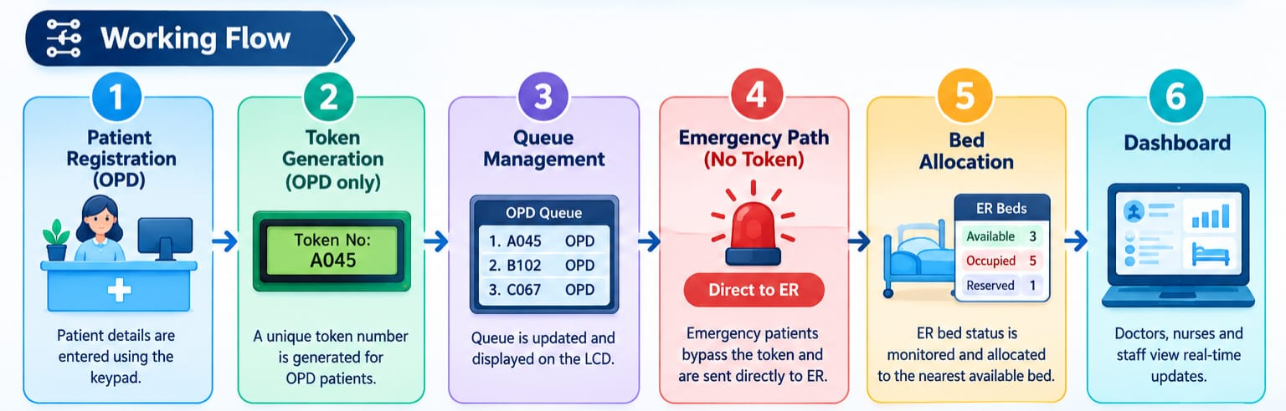
TECHNICAL APPROACH
Hacksphere

Slide 4
FEASIBILITY AND VIABILITY
Hacksphere
Feasibility
Uses low-cost and easily available technologies.
ESP32 can be used for the IoT prototype.
Web application can be accessed from computers or smartphones.
Can initially be implemented as a prototype and later scaled to hospitals.
Challenges
Bed status may not always be updated.
Network/internet failure.
Incorrect patient information.
Solutions
Simple one-click bed status update.
Periodic data verification.
Local/fallback display for important information.
Role-based access for hospital staff.

Slide 5
IMPACT AND BENEFITS
Hacksphere
Impact
Reduces unnecessary patient waiting time.
Helps staff identify emergency cases quickly.
Makes ER bed availability easier to monitor.
Improves coordination between reception, doctors and nurses.
Benefits
Social: Better patient experience and faster emergency response.
Economic: Better utilization of hospital beds and staff.
Operational: Centralized real-time queue and bed information.
Scalable: Can be extended to multiple departments and hospitals.

Slide 6
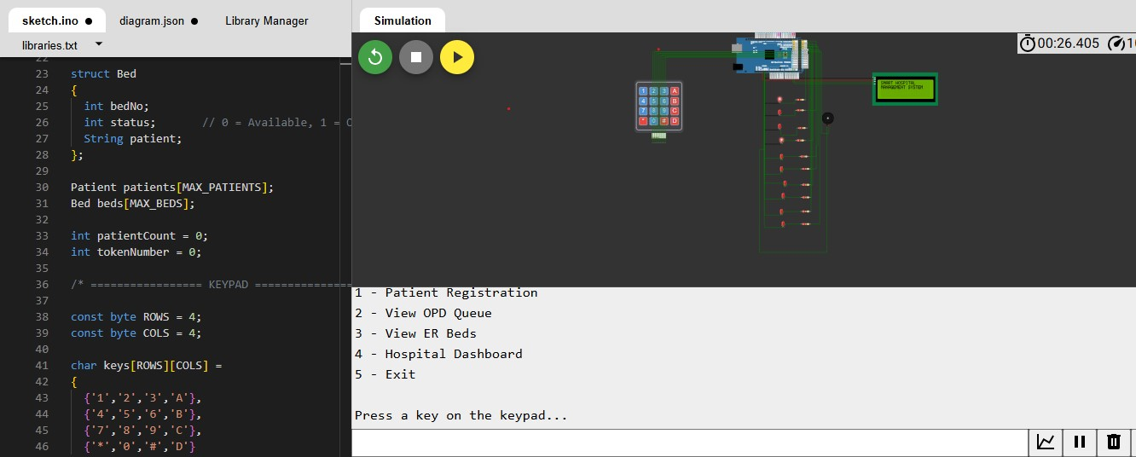
PROTOTYPE SUBMISSION
Hacksphere
Prototype Components
Software Prototype
Patient Registration
OPD Token Generation
Queue Dashboard
Emergency Priority
ER Bed Dashboard
Hardware Prototype
ESP32IR/Ultrasonic Sensor
LEDs
Buzzer
Breadboard and jumper wires
KeyPad

Slide 7
THANK YOU!....

